Slide 1
Learning to live IN 3D
Decarbonization
Decoupling
Degrowth

Slide 2
AGENDA
In this talk, I discuss the evolution of the high energy growth paradigm of northern modernity through the overlapping energy regimes of new world plantations (sucropolitics), machinic industrialism (carbopolitics) and plastic mobilization (petropolitics) to help identify some of the key areas of intervention for what I term “decompositional politics” (Boyer 2023). Then I turn to a discussion of three key frontlines of decompositional politics today: decarbonization (decomposing the sucro/carbo/petrostate), degrowth (decomposing habits and systems of productivity-for-its-own-sake) and decoupling, which is, in many respects, the most paradoxical and elusive of the three projects. On the face of things, decoupling seeks to emancipate high energy modernity from its burden of ecological unsustainability while promising at the same time to justly secure the pleasures and luxuries of high energy modernity for all. It sounds too good to be true and indeed recent studies cast serious doubt on the reality of decoupling economic growth from carbon emissions. Is this simply another seductive petrocultural mirage? Perhaps. But it is intriguing that some of the more persuasive degrowth proponents seem to see decoupling as a real possibility under the right circumstances. One striking consonance between decompositional and degrowth politics is the belief that a low energy modernity is not only possible but scalable and sustainable.

Slide 3
PRIMARY GOAL
Annual revenue growth

Slide 4
AREAS OF GROWTH
​ | CATEGORY 1 | CATEGORY 2 | CATEGORY 3​ | CATEGORY 4​
Q1 | 4.5​ | 2.3​ | 1.7​ | 5​.0
Q2 | 3.2​ | 5.1​ | 4.4​ | 3​.0
Q3 | 2.1​ | 1.7​ | 2.5​ | 2.8​
Q4 | 4.5​ | 2.2​ | 1.7​ | 7.0

Slide 5
AREAS OF GROWTH in modern energy (through successive yet overlapping, compounding energopolitical regimes since the mid 15th century)
​ | SUCROPOLITICS | CARBOPOLITICS | PETROPOLITICS​ | ELECTROPOLITICS​
Q1 | 4.5​ | 2.3​ | 1.7​ | 5​.0
Q2 | 3.2​ | 5.1​ | 4.4​ | 3​.0
Q3 | 2.1​ | 1.7​ | 2.5​ | 2.8​
Q4 | 4.5​ | 2.2​ | 1.7​ | 7.0

Slide 6
SUCRO

Slide 7
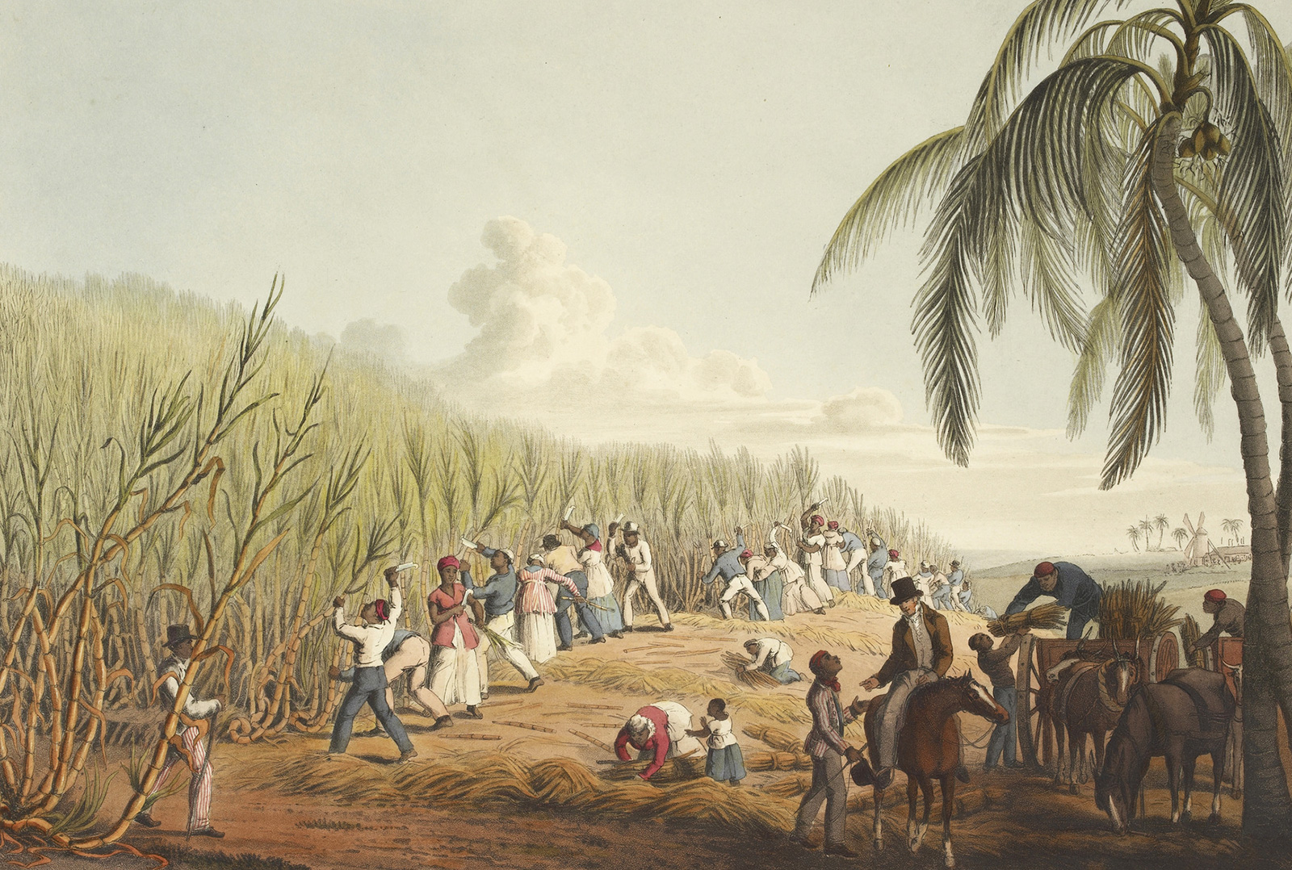
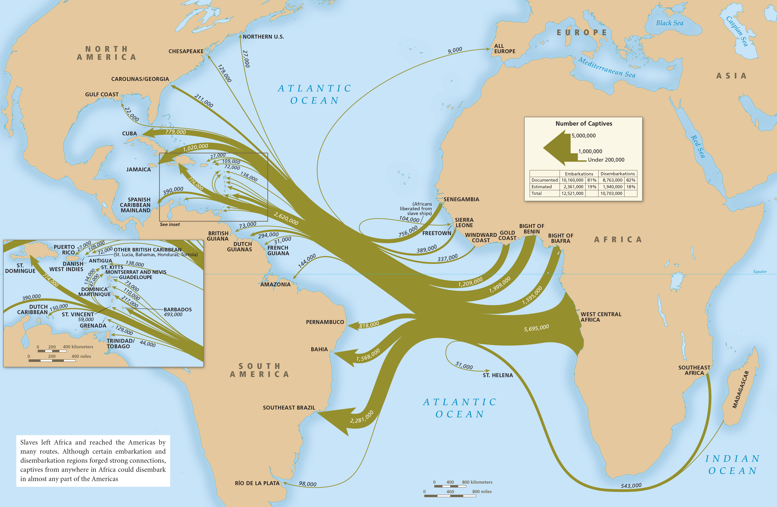
The sucropolitical catalyst of European modernity
European trans-Atlantic expansion follows Iberian sugar cultivation from Madeira and the Canaries to São Tomé (1420s to 1490s)
Columbus brings sugar cane on his second voyage to the Americas in 1493 with the aim of establishing plantations
New World sugar cane plantations created by Portuguese in Brazil in the 1520s; by the early 17th century European powers vie to spread sugar and coffee plantations across the Caribbean
Transatlantic African slave trade accelerates after 1600 to provide labor power for the “plantationocene” (Tsing, Haraway)
The materiality of sugarcane necessitates industrial and mechanical inventions, including the pioneering use of steam engines, which spread back to Europe as “industrial revolution”
Sugar wealth empowers Europe’s merchant and commercial classes; their class ideology (liberalism) emphasizes work as virtue and depicts the New World as a terra nullius of such abundance that it permitted endless plunder and growth of private property by the “industrious and rational” (Locke)
In the colonization of the new world, Europeans organized “human property as extractable energy properties.” – Kathryn Yusoff

Slide 8
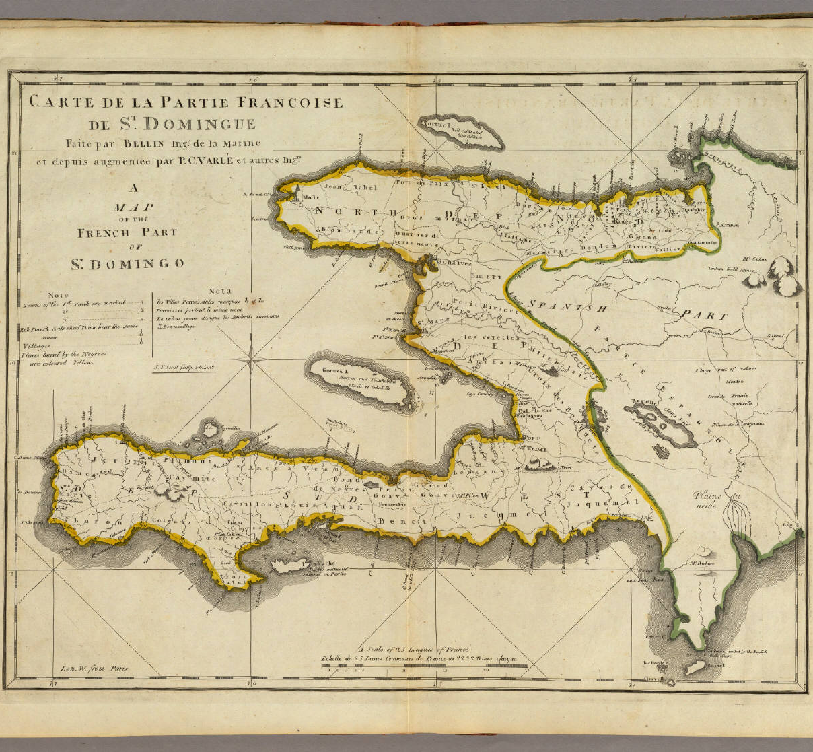
Peak sucropolitics: Haiti
With 3,000 plantations in the 1780s, Saint-Domingue is Europe’s most valuable colony, exporting 60% of all the coffee and 75% of all the sugar consumed in Europe, more than all Britain’s so-called West Indian colonies combined. The colony is the undisputed “crown jewel” of transatlantic plantation capitalism
Saint-Domingue imports up to 40k slaves a year. At one point it alone represented more than 1/3rd of the Atlantic slave trade.
Meanwhile, back in France, 20% of the bourgeoisie have their wealth tied directly to slave-related commercial activity.
The coordinated uprising of Saint-Domingue’s slaves began in August 1791; it was 12 years of bloody civil war before the island’s forces finally defeated Napoleon’s effort to recapture the colony in 1802-1803. The first Haitian constitution was authored in 1801 and exceeded American and French revolutionary documents in its rights and freedoms. Yet 40% of the Haitian population died during its wars of liberation.
In exchange for diplomatic recognition from France, Haiti was forced to pay enormous reparations (150 million francs, $21 billion today). The audacity of self-emancipation led to northern revenge in the form of what was possibly the longest period of odious debt bondage in modern history (1825 until 1947) leaving Haiti one of the poorest countries in the world

Slide 9
Carbo

Slide 10
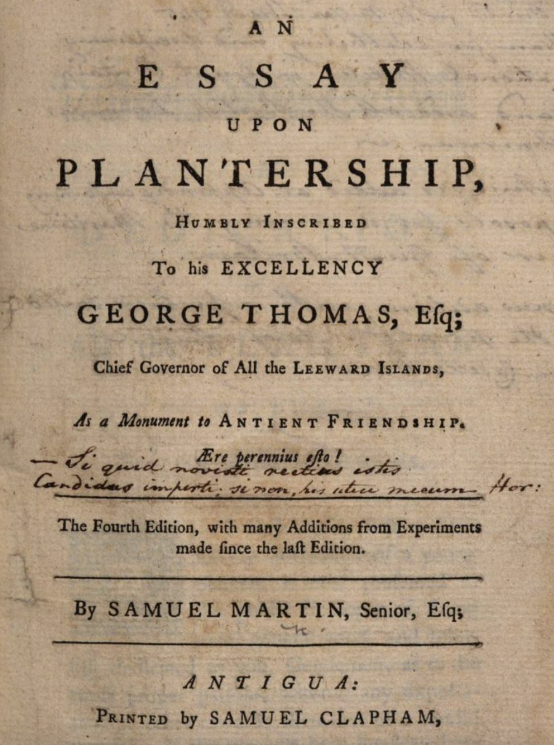
After the Haitian revolution, plantation sucropolitics and transatlantic capitalism begin to transform with a new emphasis upon mechanization. Back in Europe this registers as a new conception of energy as “work” takes shape, particularly in Victorian Britain
Tellingly, this modern conceptualization of energy as work was already familiar to Caribbean plantation masters. In a plantation manual published in 1754, one Samuel Martin wrote that “Negroes, cattle, mules, and horses are the nerves of a sugar-plantation, for the success of the whole consists chiefly in this, as in a well-constructed machine, upon the energy and right disposition of the main springs, or primary parts.”
According to Daggett, steam engines, empire, thermodynamics and Presbyterianism help cement a new conceptualization of energy as “work” always threatened by a cosmic propensity to dissipation/waste
Civilizational hierarchy redefined through capacity for work, constituting an “energetic racism” further legitimating imperial expansion and dispossession
Fossil fuel use and wage labor are naturalized as social necessities for human improvement, reinforcing the obsession of capitalist economies with work and growth

Slide 11
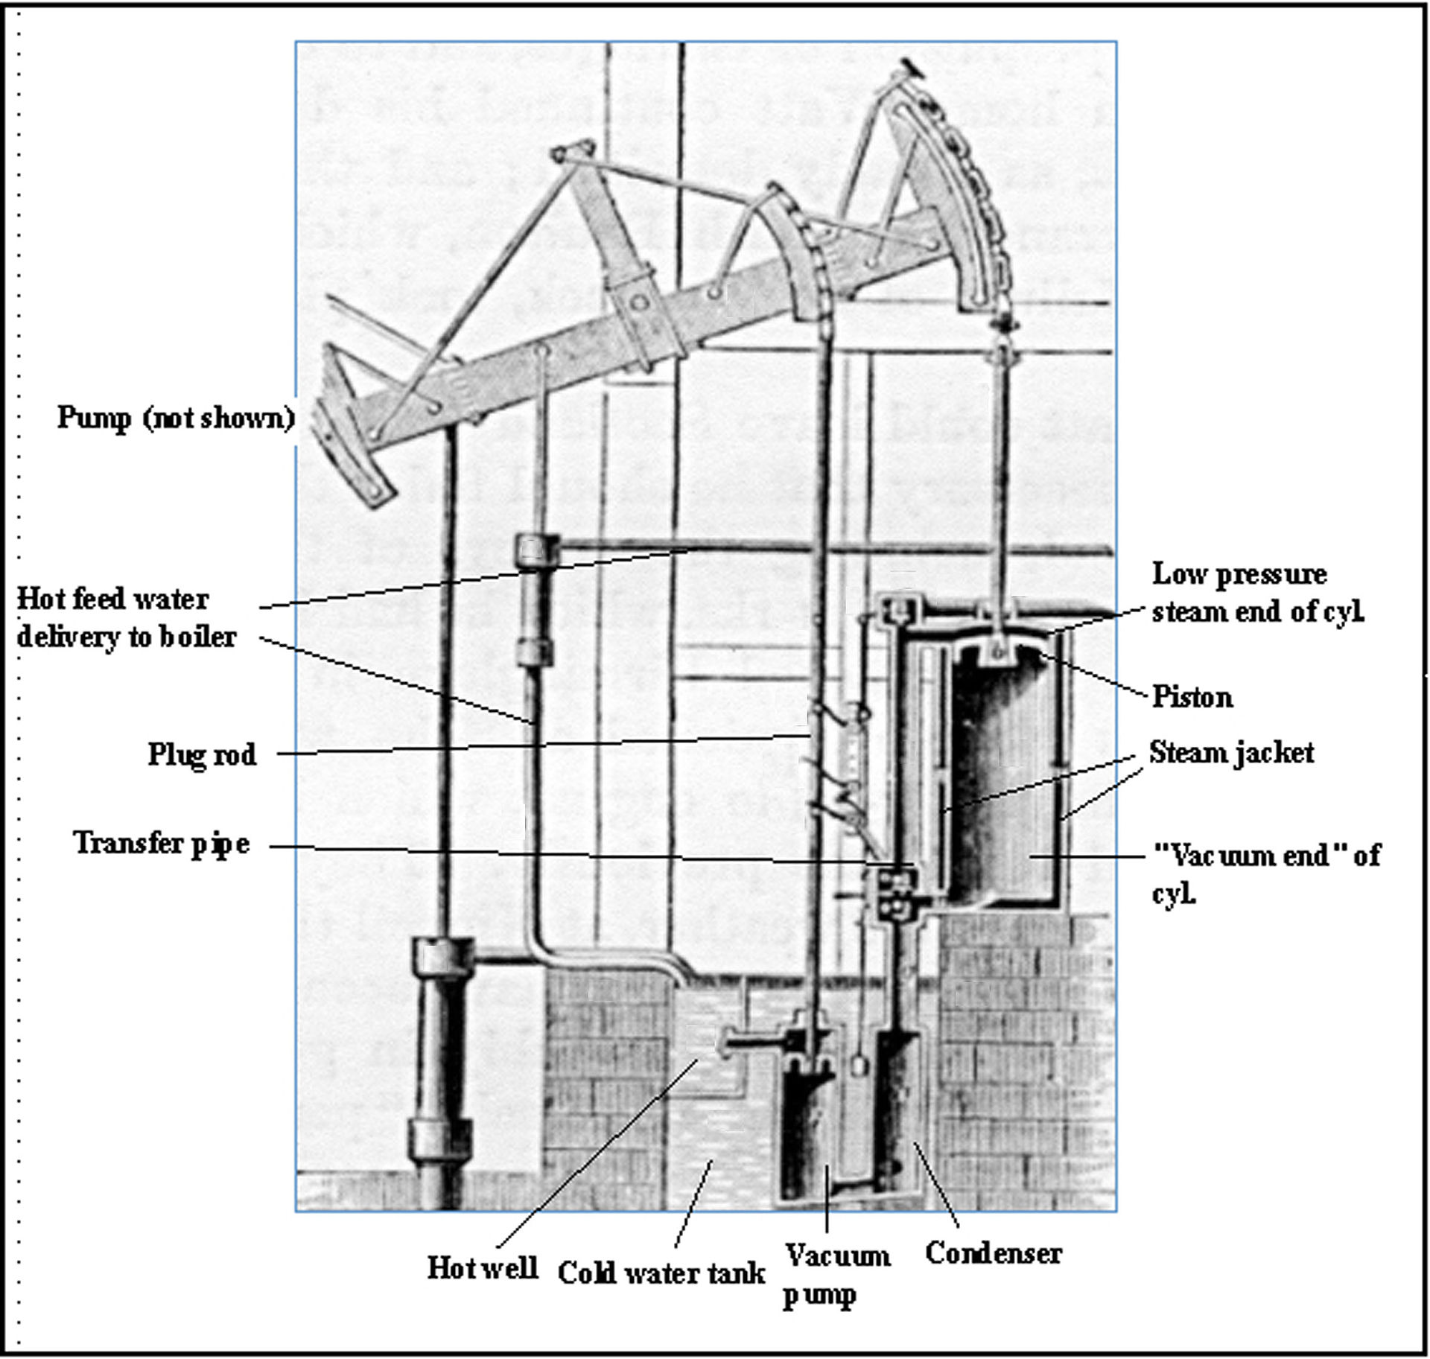
Carbopolitics, commodities and CONSUMERISM
Alongside the sucropolitics of plantation slavery, the coal energy regime has been the single most important force in formalizing European standards of modernity, domesticity and economy
Carbopolitics centers on the immense application of mechanical energy to create commodities cheaply, quickly and reliably. A “democracy of things” (Barbour et al) takes shapes over the course of the 19th century creating new standards of necessity and luxury. Machines cheapen the social value of artisanal labor
Coal energy allows capital new political advantages over labor, driving urbanization and industrialism (Malm); it also creates a transportation revolution with steam-powered locomotion coming to epitomize the pace and power of modernity over space and time (L. Marx)

Slide 12
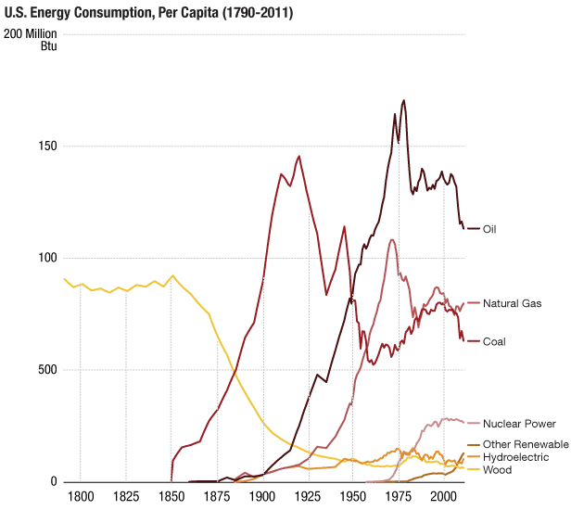
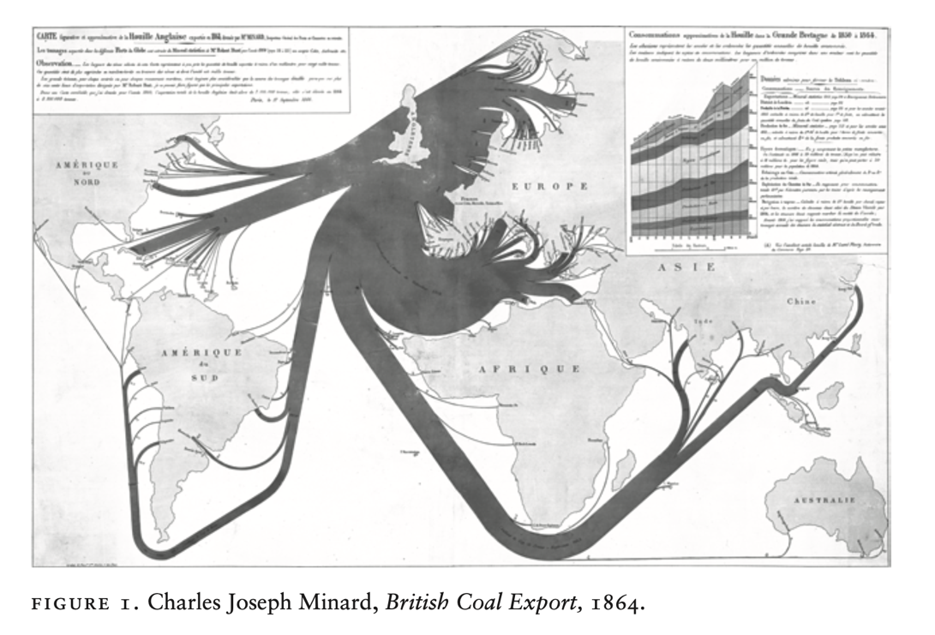
A so-called second industrial revolution dawns driven by steel, chemicals and electricity
Coal use quintuples in the last quarter of the 19th century; by 1900, coal constitutes 85% of British international trade (“coalonialism” – Barak)
A new carbopolitical nexus of coal and steel enables the rise of new industrial and imperial powers in the US and Prussia
Late carbopolitics sees industrialization and militarization expanding hand in hand, creating a new world order occupied by Euroamerican coal, machines and steel
Extractivist zones spread and intensify via steel, steam and rail (e.g., the scramble for Africa)
Peak carbopolitics arrives in the mechanical, industrial warfare of Euroamerican imperialism and WWI

Slide 13
petro

Slide 14
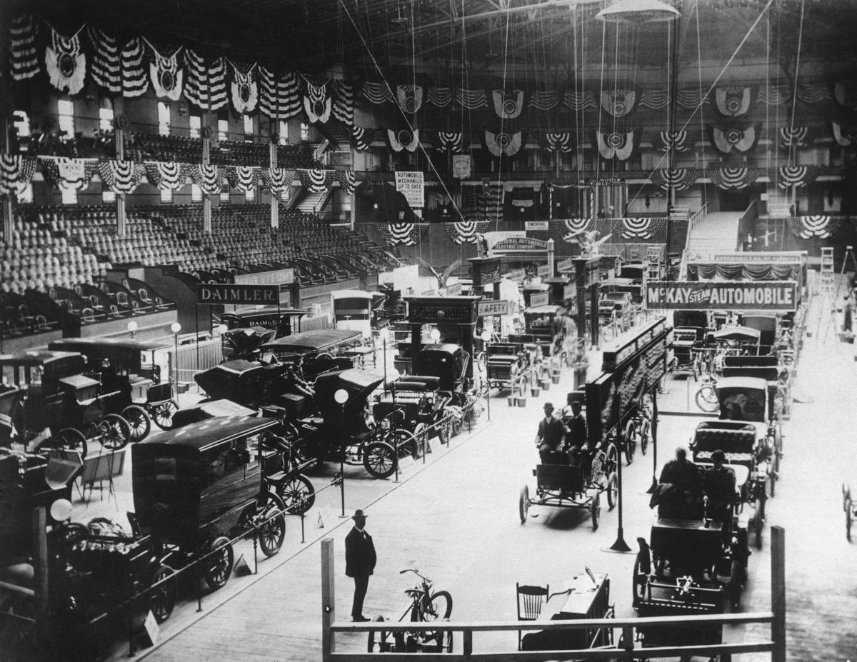
Automobility as catalyst for petroculture
In the late 1880s the first functional electric car prototypes arrived and ushered in a lively competition between steam, electric and gasoline powered vehicles over the next three decades
It was not until Ford’s Model T (and the Texan oil boom) that gas cars came to dominate the auto market in the 1910s. Transportation fuel has driven oil consumption ever since
The automobile has a surprisingly deep and complicated history, one that intertwined with the locomotive for many decades. A rail-less automotive machine was a serious aspiration of inventors no later than the end of the 18th century
Despite the rise of the locomotive, the aspiration of automobility endured—the liberation of fast machinic travel beyond pre-determined routes was a perfect expression of carbopolitics and its thirst for machinic freedoms
A wide variety of experimental automobility technologies evolved in the last decades of the 19th century. Many were steam-powered, some burned a variety of kinds of oil; there was even a hydrogen fuel prototype.
First US national auto show, 1900 >>

Slide 15
After wwi, the limitations of coal-fueled industrial capitalism and “carbon democracy” became evident. Oil involved less unruly labor and had many material advantages over coal (e.g. higher energy density, fluidity, plasticity). Petroknowledges begin to flourish. By the mid 20th century “growth” is the sine qua non of something called “the economy” and petroleum and derivative plastics become essential material forms across the planet. The world enters, unevenly, into an era of global petroculture: lifeworlds defined by mobility and consumerism, cheap goods and rampant energy use without regard for environmental and social consequences
Energy consumption in the United States (in quadrillion BTU)
“Reports of oil’s death have been greatly exaggerated.” – Stephanie LeMenager
“Fossil fuels helped create both the possibility of twentieth-century democracy and its limits.” – Timothy Mitchell

Slide 16
Ballpoint Pens, Football Cleats, Upholstery, Sweaters, Boats, Insecticides, Bicycle Tires, Sports Car Bodies, Nail Polish, Fishing lures, Dresses, Tires, Golf Bags, Perfumes, Cassettes, Dishwasher parts, Tool Boxes, Shoe Polish, Motorcycle Helmet, Caulking, Petroleum Jelly, Transparent Tape, CD Player, Faucet Washers, Antiseptics, Clothesline, Curtains, Food Preservatives, Basketballs, Soap, Vitamin Capsules, Antihistamines, Purses, Shoes, Dashboards, Cortisone, Deodorant, Footballs, Putty, Dyes, Panty Hose, Refrigerant, Percolators, Life Jackets, Rubbing Alcohol, Linings, Skis, TV Cabinets, Shag Rugs, Electrician's Tape, Tool Racks, Car Battery Cases, Epoxy, Paint, Mops, Slacks, Insect Repellent, Oil Filters, Umbrellas, Yarn, Fertilizers, Hair Coloring, Roofing, Toilet Seats, Fishing Rods, Lipstick, Denture Adhesive, Linoleum, Ice Cube Trays, Synthetic Rubber, Speakers, Plastic Wood, Electric Blankets, Glycerin, Tennis Rackets, Rubber Cement, Fishing Boots, Dice, Nylon Rope, Candles, Trash Bags, House Paint, Water Pipes, Hand Lotion, Roller Skates, Surf Boards, Shampoo, Wheels, Paint Rollers, Shower Curtains, Guitar Strings, Luggage, Aspirin, Safety Glasses, Antifreeze, Football Helmets, Awnings, Eyeglasses, Clothes, Toothbrushes, Ice Chests, Footballs, Combs, CD's & DVD’s, Paint Brushes, Detergents, Vaporizers, Balloons, Sun Glasses, Tents, Heart Valves, Crayons, Parachutes, Telephones, Enamel, Pillows, Dishes, Cameras, Anesthetics, Artificial Turf, Artificial limbs, Bandages, Dentures, Model Cars, Folding Doors, Hair Curlers, Cold cream, Movie film, Soft Contact lenses, Drinking Cups, Fan Belts, Car Enamel, Shaving Cream, Ammonia, Refrigerators, Golf Balls, Toothpaste, and thousands more products besides…
Petroculture’s material revolution:
One 42-gallon barrel of oil creates 19.4 gallons of gasoline. The rest (over half) is used to make things like ->

Slide 17
What’s on the horizon past sucro, carbo, petro?

Slide 18
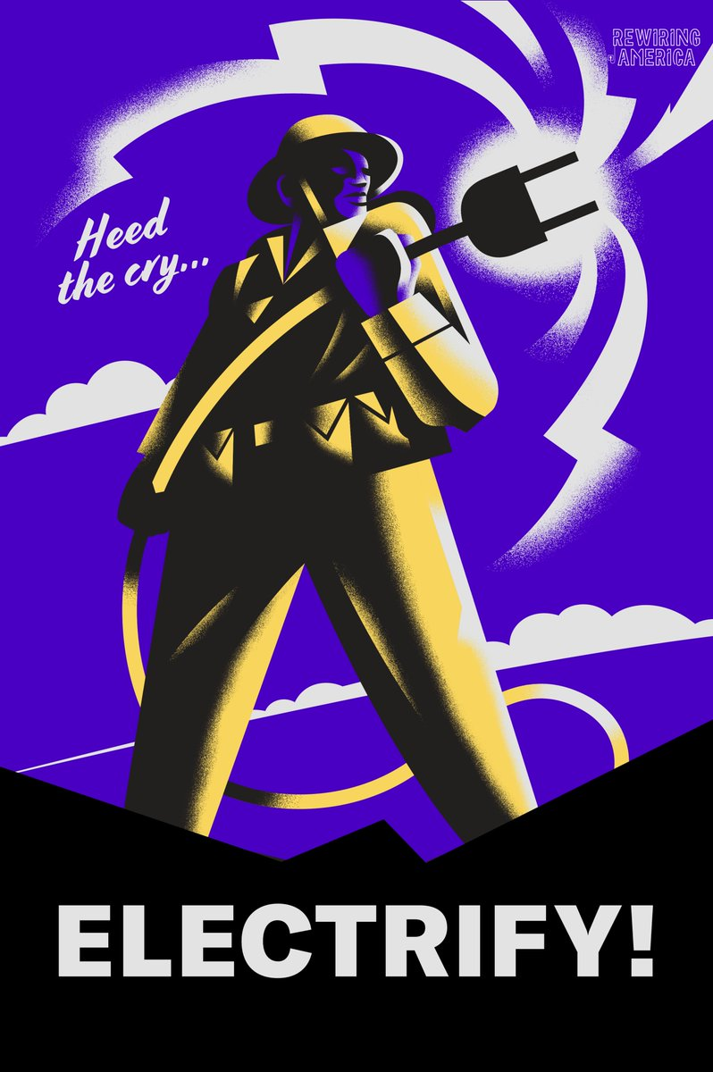
Most likely electro
Robust electropolitical infrastructures already exist and, spurred on by the climate emergency, there has been a distinct and widespread movement toward the fusion of energy and electricity.
“Electrify everything” has become a mantra of climate experts the world over.
Yet, by itself, electrical infrastructure cannot disrupt the world made by sucro, carbo, petro. Indeed, if history is any guide, it is more likely that electroculture will emerge deeply shaped by the grooves of petroculture, just as petroculture was heavily influenced by the carboculture and sucroculture that preceded it.
We are already seeing many experts demanding more power plants, more grid and new resource frontiers so that electroculture can meet the needs and exceed the pace of petrocultural expansion.
An electrified petroculture is not enough. It will take more and also less to accomplish the remaking of a world that breaks in fundamental ways with the ecocidal trajectory we have inherited.

Slide 19
Decarbonization

Slide 20
The good news is that it is finally starting to happen, sometimes dramatically so

Slide 21
It is good news, isn’t it?

Slide 22
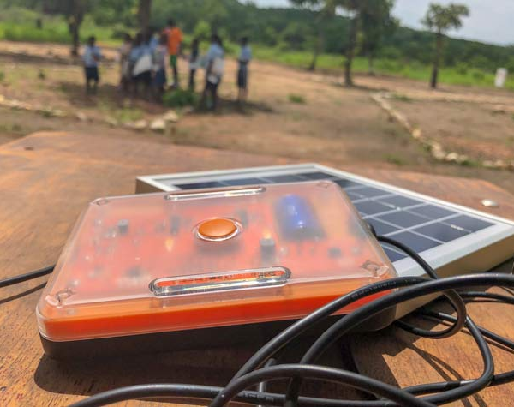
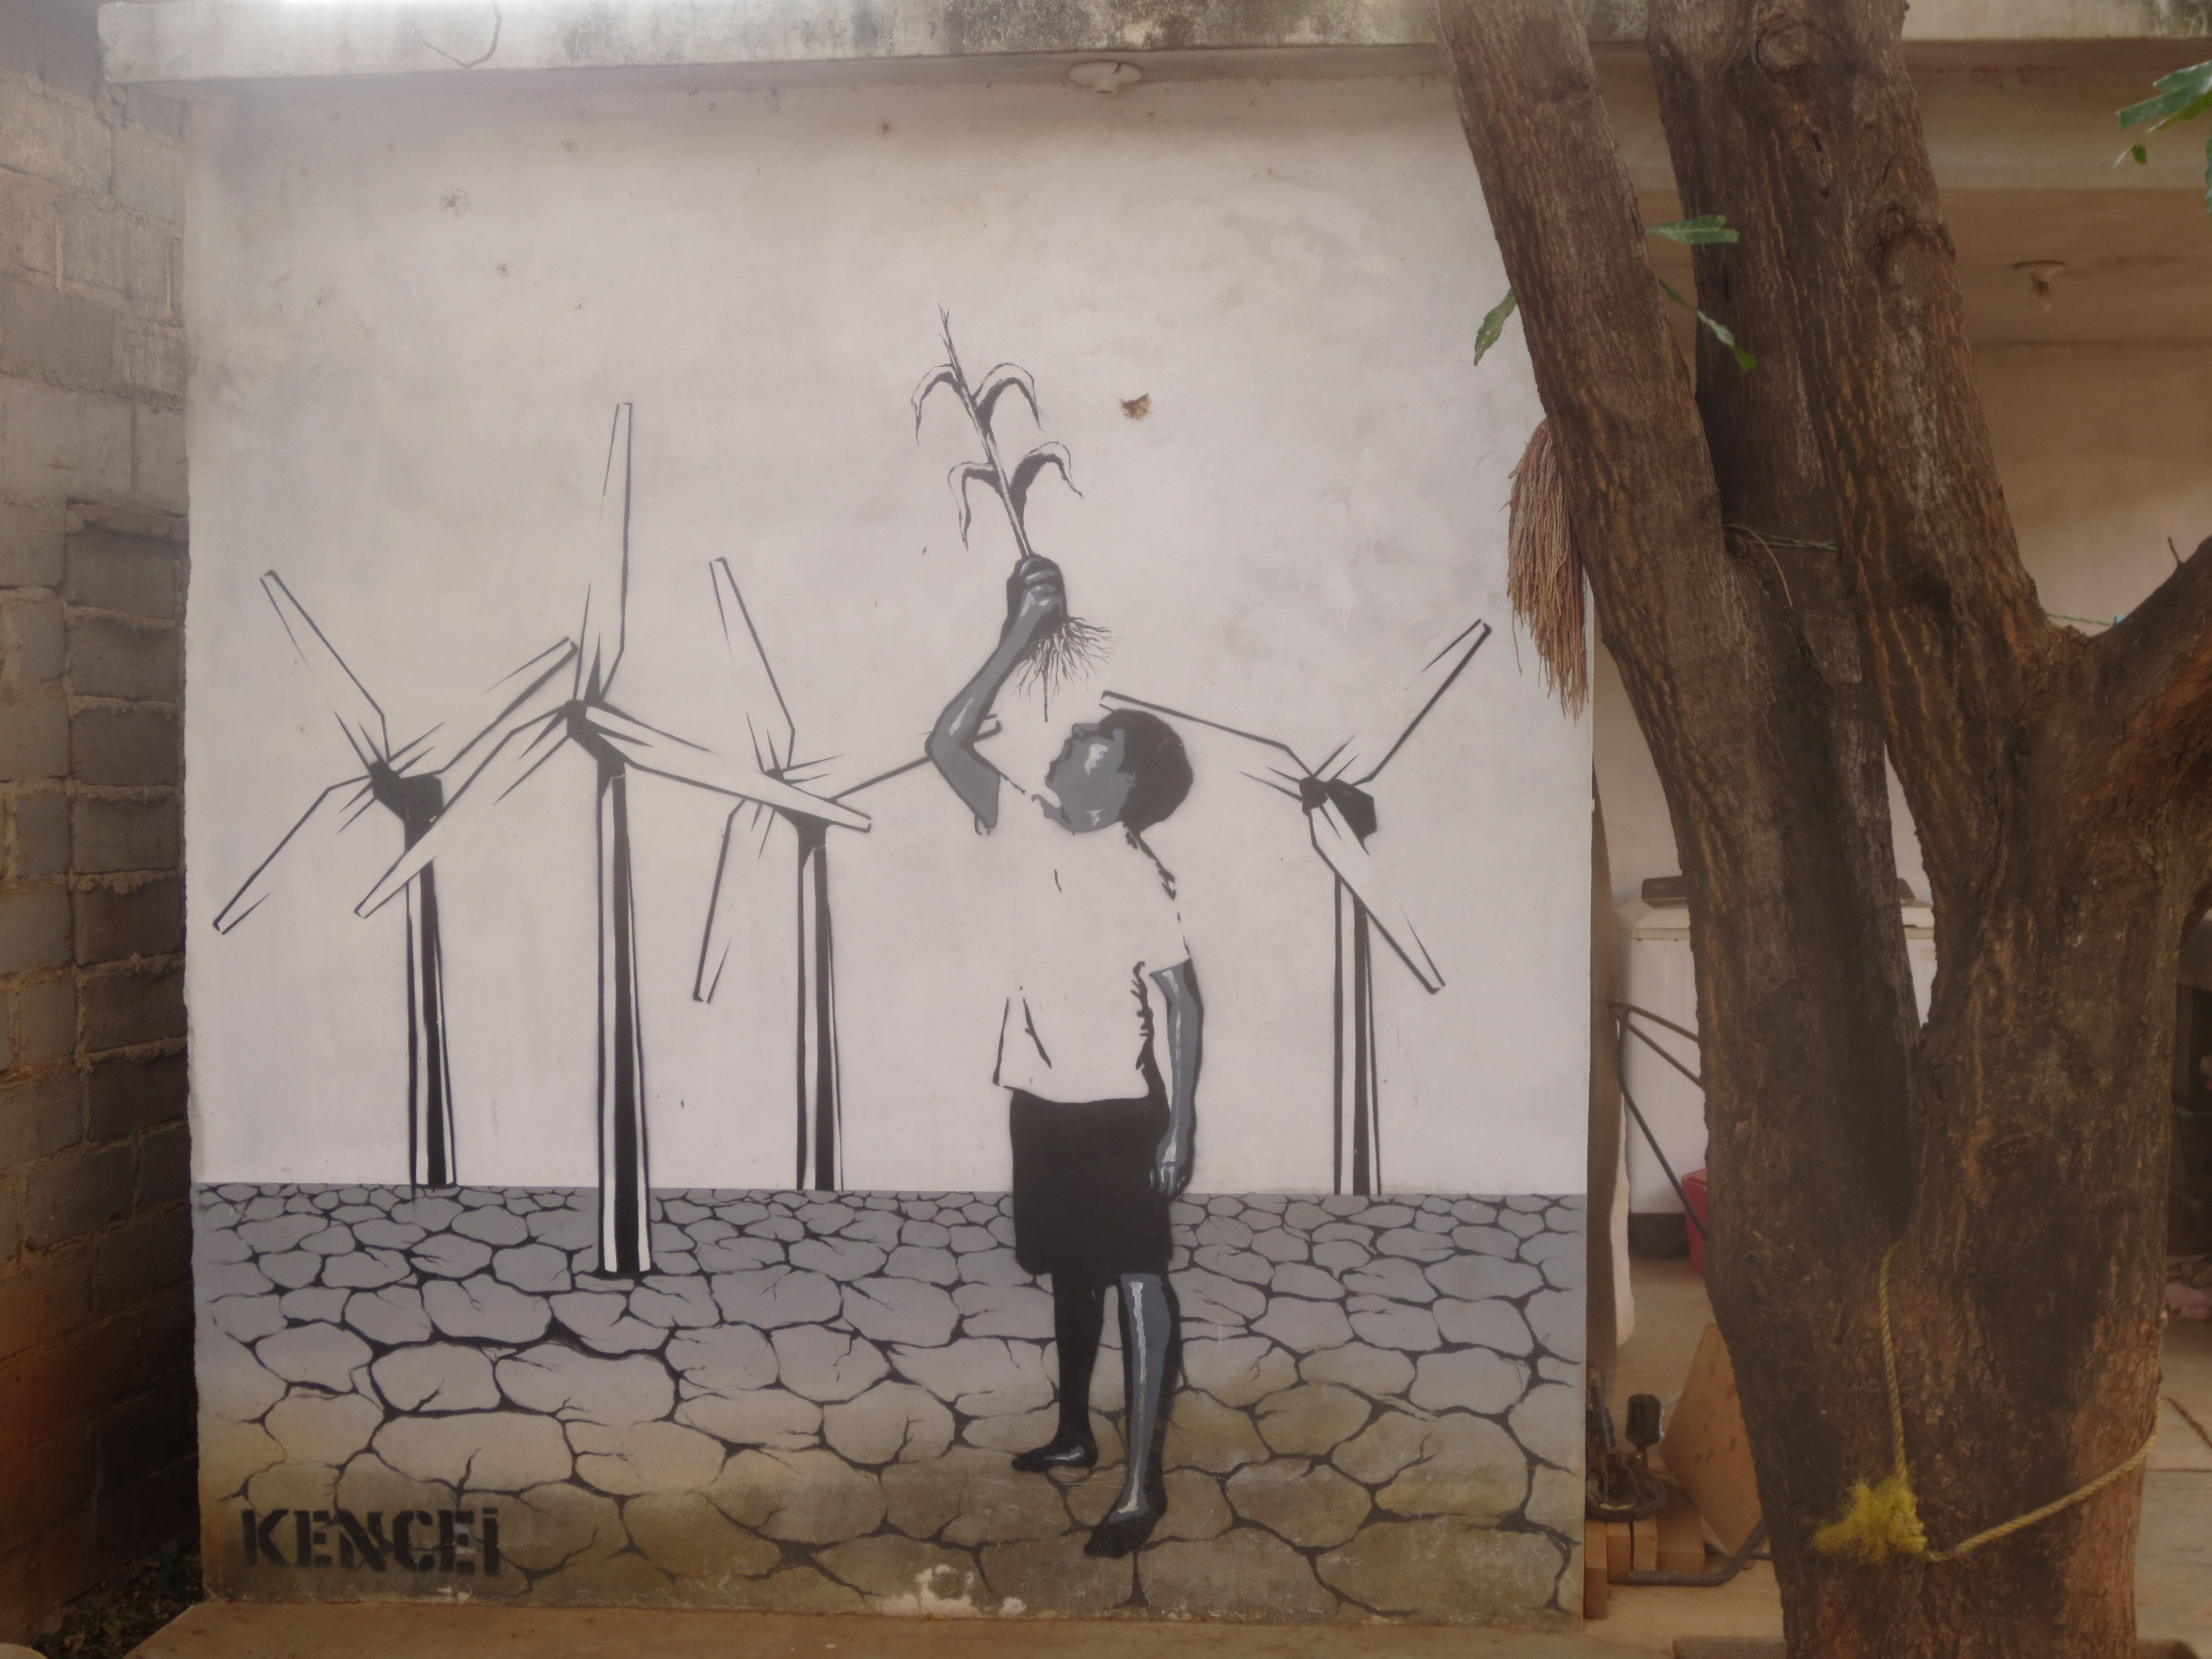
The bad news is that extractivist, productivist sucro/carbo/petropolitical ideology and infrastructure persist, reproducing colonial & ecocidal relations, unevenly but everywhere

Slide 23
There are basically two kinds of arguments that high energy productivity, consumption and economic growth are infinitely sustainable:
Technological salvation (e.g., a we-get-to-have-it-all energy solution like nuclear fusion appears, combined with advances in materials science and recycling)
Decoupling and “green growth” (e.g., through efficiency gains and energy transition, economic development can increase without increasing environmental burden)

Slide 24
decoupling

Slide 25
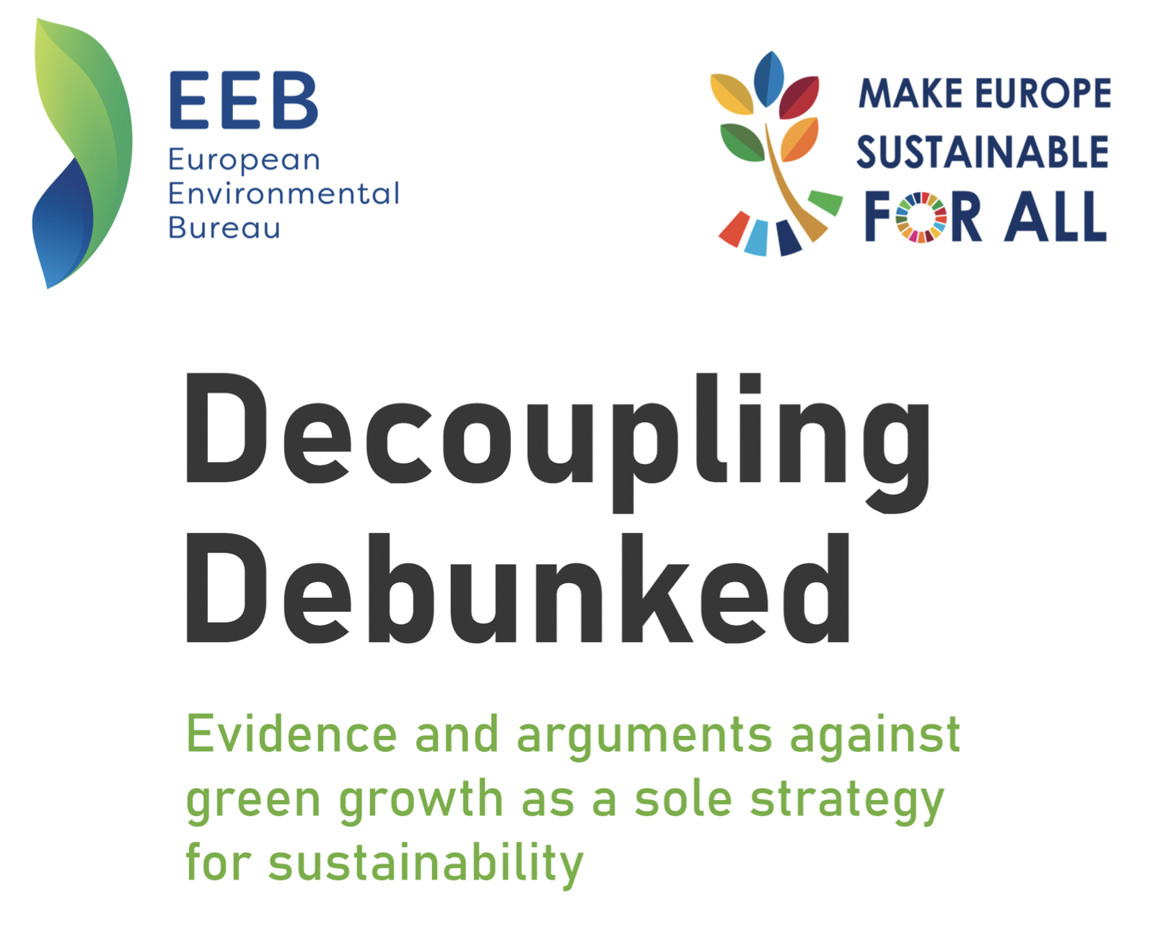
Decoupling debunked!
Absolute vs relative decoupling (or, the problem of offshoring emissions)
Absolute decoupling is extremely difficult to accomplish and maintain
A major study published in 2021 that looked at both production- and consumption-based emissions from 2015 to 2018 in 116 mostly high-carbon national economies found that only 14 of them had been able to decouple GDP growth from both types of emissions growth. That might seem like progress, since a similar study published in 2012 found that zero countries had achieved decoupling. But the 2021 study also found that 22 countries that had managed to decouple between 2010 and 2015 had actually recoupled again after 2015
Jason Hickel (2020): “Absolute decoupling of GDP from emissions can be achieved simply by replacing fossil fuels with renewable energy; but this cannot be done quickly enough to respect carbon budgets for 1.5°C and 2°C if the economy continues to grow at usual rates. More growth means more energy demand, and more energy demand makes it all the more difficult to cover it with renewables in the short time we have left.”

Slide 26
degrowth

Slide 27
Degrowth emerges conceptually in response to the Club of Rome’s Limits of Growth report in 1972

Slide 28
Limits to Growth (1972) revisited
“If the present growth trends in world population, industrialization, pollution, food production, and resource depletion continue unchanged, the limits to growth on this planet will be reached sometime within the next one hundred years. The most probable result will be a rather sudden and uncontrollable decline in both population and industrial capacity.”
The original study predicted crisis through resource depletion. Revised modeling predicted pollution as an equivalently important concern (e.g. plastic waste, greenhouse gas emissions)

Slide 29
André Gorz coins the term “décroissance”
What is it we want? “a capitalism adapted to ecological constraints; or a social, economic, and cultural revolution that abolishes the constraints of capitalism and, in so doing, establishes a new relationship between the individual and society and between people and nature? Reform or revolution?”

Slide 30
Gorz termed this constant process of dispossession through innovation the “poverty of affluence” and argued that to break with the “ideology of growth”, a society would first have to affirm a set of values opposed to hierarchy and privilege. Gorz imagined the world of décroissance as one defined by universally available highly durable goods, beautiful public dwellings and transportation, a twenty-hour work week focused on providing essential needs for all, with the remaining time left over for creative self-realization. This vision was, for Gorz, not utopian but rather a matter of “ecological realism” that called for active diminishment and slowing down of the pulse of modernity: “The point is not to refrain from consuming more and more, but to consume less and less—there is no other way of conserving the available reserves for future generations.”
Gorzian ideas resonate in much contemporary degrowth thinking, particularly the work of Japanese Marxian philosopher Kōhei Saitō who argues for the path of “degrowth communism” via open technologies and cooperative organization. Saitō argues that degrowth communism will permit radical abundance
Gorz preferred revolution because he viewed the growth orientation of capitalist society as inherent to its operation. Capitalism utilizes scarcity as a means for reproducing social inequality and preserving hierarchy in its class structure. New technological achievements and luxuries enjoyed first only by the elite attract the desires of the masses toward them. As the masses gain access to old luxuries, new unattainable luxuries develop to replace them. This treadmill of luxury means that no universal “good life” will ever be enjoyed in a capitalist society no matter its productive powers or accumulation of useful things—"the mainspring of growth is this generalized forward flight, stimulated by a deliberately sustained system of inequalities.”

Slide 31
In recent years, degrowth has moved from a fringe theoretical interest to serious consideration in the post-neoliberal transformation of economics. What is sometimes called “ecological economics” is undergoing its own growth revolution including important interventions by Kate Raworth (2018) on doughtnut economics and Giorgis Kallis (2018) and Timothée Parrique (2022) on theorizing degrowth as an active program of civilizational transition.

Slide 32
Decolonizing degrowth
Degrowth sometimes has a white male savior vibe to it. But it is encouraging to see that political movements centering degrowth principles are forming and that they are beginning to recognize, respect and center the pathbreaking work of Black, Indigenous and Ecofeminist critiques of growth and settler colonialism (Bianchi 2012, Bauhardt 2014). As Bianchi argues, “Given, in fact, that economic growth is not a neutral process with regard to gender, the degrowth project cannot avoid investigating in depth the relationship between patriarchy and capitalism.” Growth ideology is enabled, fundamentally, by the resilience of women’s caring labor that is constantly exploited as an infrastructure for extractive practices. Bauhardt writes that ecofeminism reframes the growth crisis “as the finiteness of natural resources as well as the finiteness of women’s caring labor.” Ecofeminism has also proposed a solidarity economy as the core of a postcapitalist politics (Gibson-Graham 2006, Plumwood 1994, Warren 1994 ). This solidarity model clearly intersects with the politics of the “Red Deal” (The Red Nation, 2021) which promotes direct Indigenous action toward a “caretaking economy” in place of either capitalist growth or the vague ecopolitics of a sustainability economy.

Slide 33
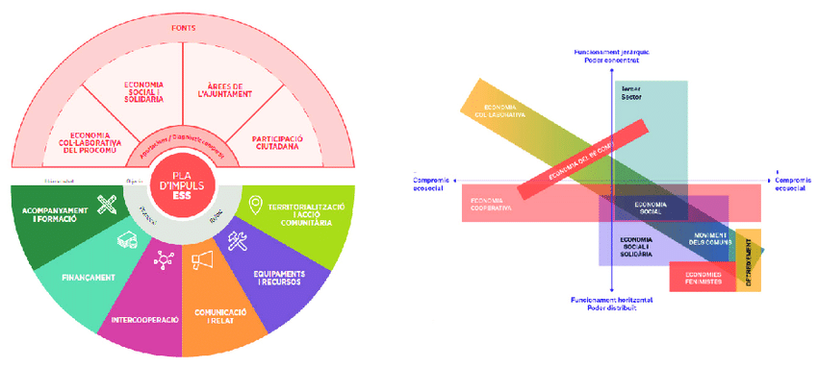
Are degrowth policies gaining traction anywhere in the global North?
In some places, yes, for example in Barcelona where early experiments in creating a “solidarity economy” are showing encouraging results
Cooperatives like Som Energía and Som Mobilitat are more than conventional service providers offering electricity and EV ride sharing, respectively. They promote energy literacy and degrowth ethics, helping their customers learn to use less power and to drive only when truly necessary. Som Mobilitat sponsored a energy efficiency race in which the objective was to see who could travel the farthest on a set charge
Plus, much of Europe recently engaged in an ambitious (if also largely involuntary) degrowth exercise in energy usage owing to Russian energopolitics and its invasion of Ukraine

Slide 34
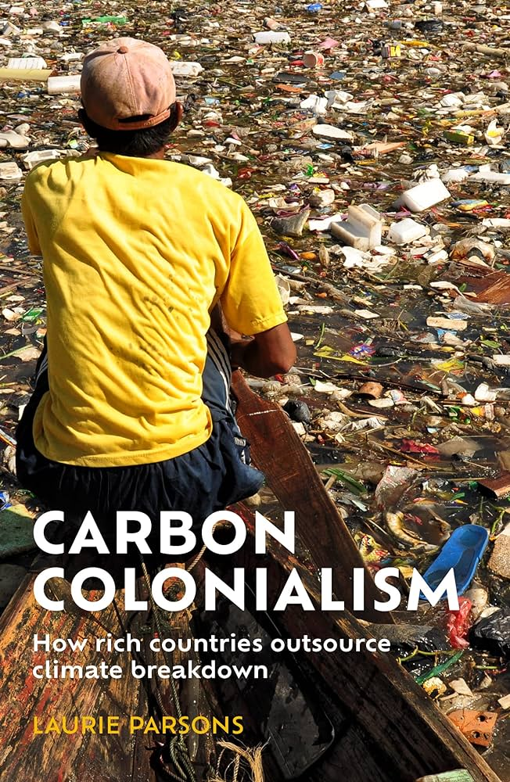
But why stop at living in 3-D? shouldn’t we be living in 4-d? Or even 5-D?

Slide 35
decomposition
”We are compost. Not posthuman.” – Donna Haraway

Slide 36
frontlines of decompositional politics today include:
Decomposing the petrostate (e.g., the military-industrial-extractivist-mobilist-consumerist complex)
Decomposing petrohabits (e.g., especially in the Global North we must rediscover more ways of becoming less together [subscendence, hyposubjects])
Decomposing petroknowledge (e.g., occupy this powerpoint!)
WHAT IS TO BE DONE?
Fossilized inheritances are more brittle than they seem. We need decompositional politics that unmake the ecocidal trajectory that is the legacy of northern empire and recompositional politics aimed at restoring relational possibility and futurity

Slide 37
BUSINESS OPPORTUNITIES ARE LIKE BUSES. THERE'S ALWAYS ANOTHER ONE COMING.​
Richard Branson

Slide 38
decompositional OPPORTUNITIES ARE LIKE bacteria. THERE are 40 trillion of them in you already.
Harbors N. Rancid

Slide 39
PRIMARY GOAL
Annual growth of decomposition

Slide 40
MEET OUR TEAM
TAKUMA HAYASHI
MIRJAM NILSSON
FLORA BERGGREN
RAJESH SANTOSHI
President
Chief Executive Officer
Chief Operations Officer
VP Marketing
GRAHAM BARNES
ROWAN MURPHY
ELIZABETH MOORE
DOMINIC BOYER
VP Product
SEO Strategist
Product Designer
Content Developer

Slide 41
THANK YOU
Dominic Boyer
dcb2@rice.edu
www.dominicboyer.org

